Slide 1
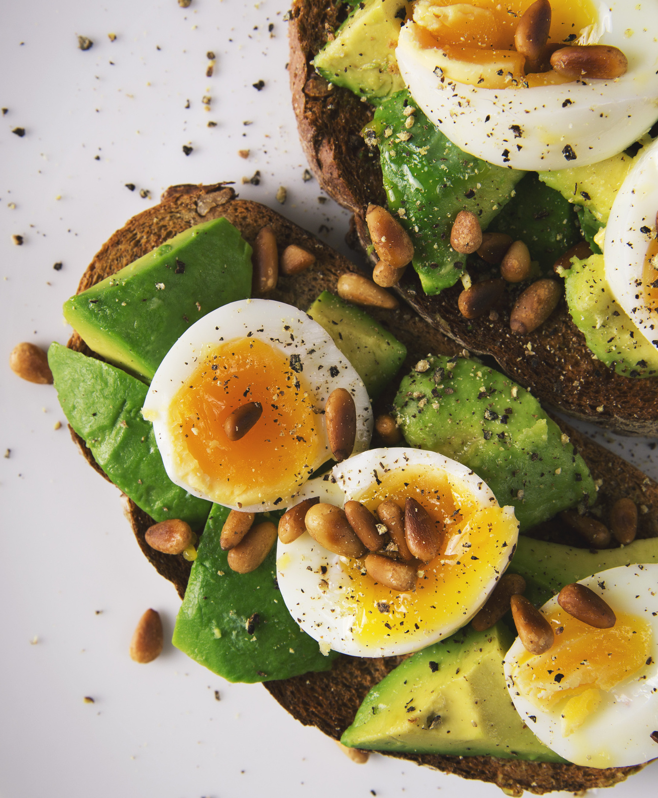
Eating Habit VS COVID-19
Exploratory Analysis Between Eating Habits and Number of Confirmed and Death Cases of COVID-19 Across Different Countries
Wendy Jiang, Sihao Feng, Bianca Xie
CSE 163 section A
08/16/2022

Slide 2
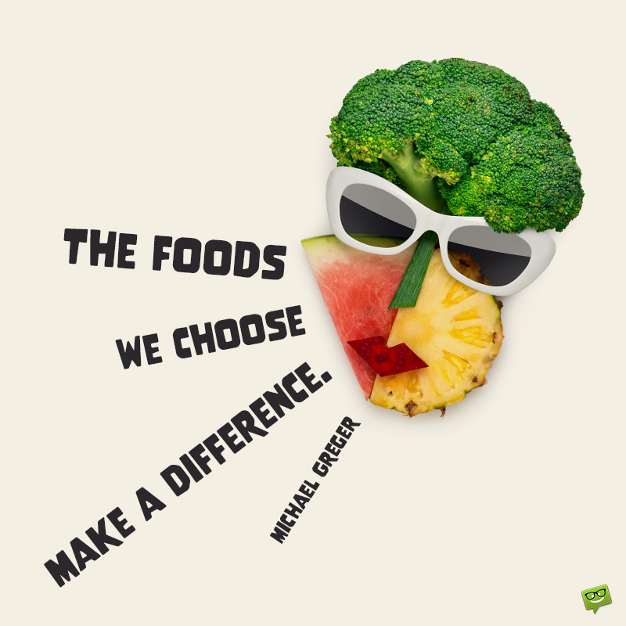

What to Expect?
Agenda for today’s presentation
Motivations
Methodology
Results, visualizations, key takeaways
Future work

Slide 3
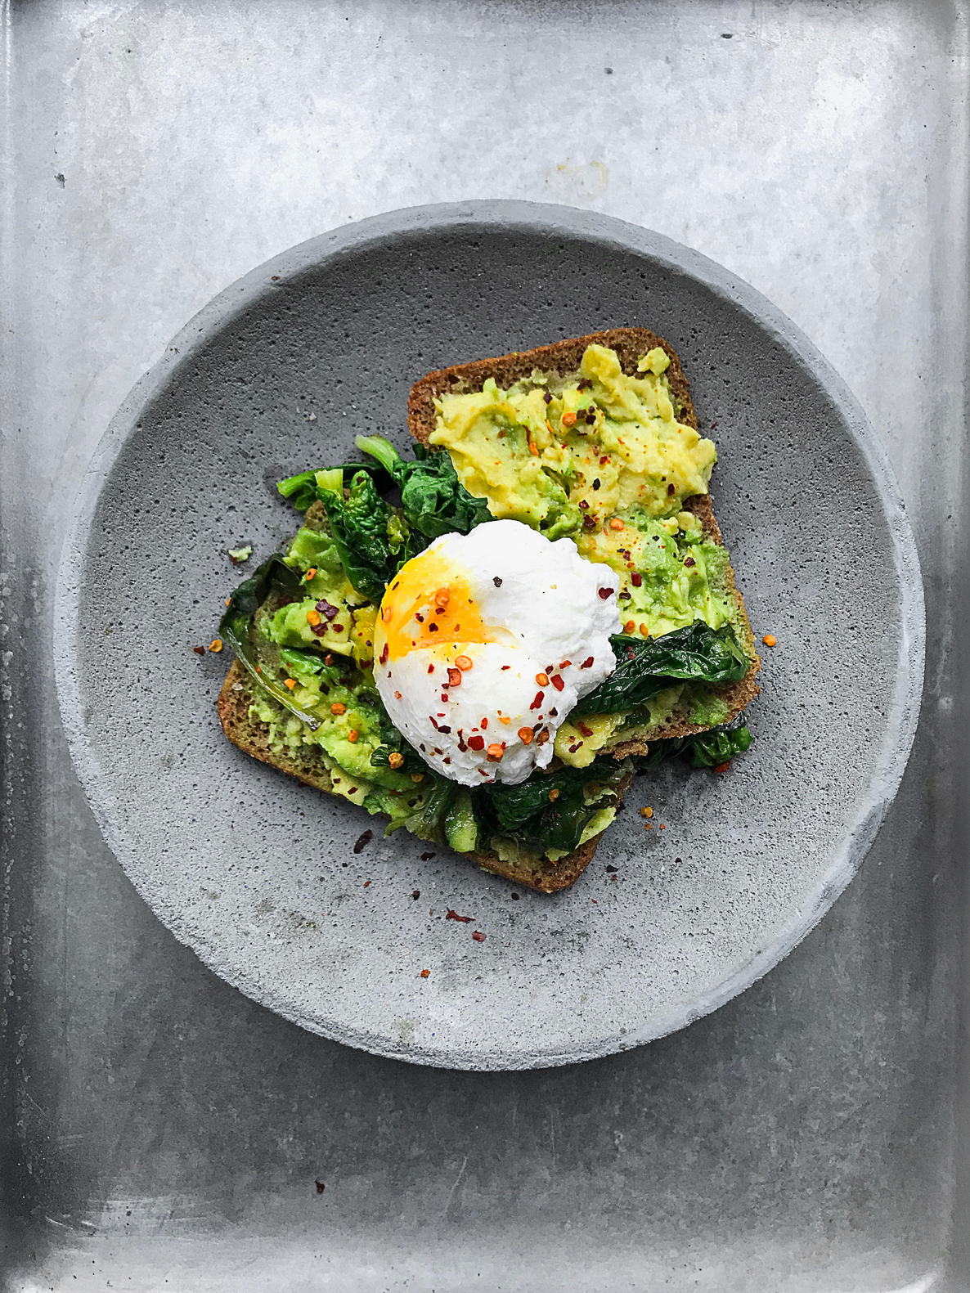
Motivations
It is about health of all mankind
COVID-19 has changed people’s eating habit
We have recognized that our eating habits have been heavily influenced due to COVID 19. Since we stay indoors more frequently and have less chance to exercise, it leads us to start to eat unhealthily and irregularly.
The changed eating habit has a bad influence on our health
The changed eating habit will lead to an unhealthy body with a weak immune system. It might cause people to increase a high chance of getting COVID.

Slide 4
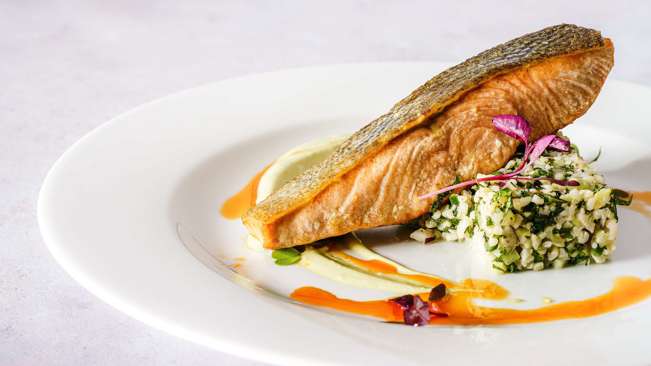
To verify our hypothesis…
We decided to research the relationship between the change in eating habits and the opportunities to get COVID-19 to encourage people to eat healthy food.

Slide 5
Methodology
01
What are the top three factors contributing to people getting COVID-19 in terms of diet?
Compute the correlation coefficient between the Covid-19 confirmed rate, recovery rate, and deaths rate columns and types of take-in ingredients columns.
Does intake of more fat or intake of more protein help people get away from COVID-19?
illustrate the distribution of intake of fat and protein from different ingredients, find the relationship between intake of fat or protein and possibility of getting away from COVID-19.
02
Is there a significant difference between undernourished countries with a higher recovery rate and lower recovery rate?
2 sample t test hypothesis testing to find the significant difference between unnourished rate and recovery rate. Use the seaborn to do visualization and comparisons.
03
Does there appear to be a relationship between the number of deaths from COVID and the amount of intake from fat?
Find the country with the highest and lowest death rate. Calculated the covariance matrix and correlation coefficient in the data
04
Split train and test data sets, train each model by using training sets, tune models by different parameters to find the best parameters of the model. Do predictions and plot the actual data with predict data, calculate the accuracy and the mse. Conclude the best tuning model.
05
Find the best tune model by comparing the predicted accuracy and mean squared error. Predicting Wendy’s diet habit’s recovery rate.

Slide 6
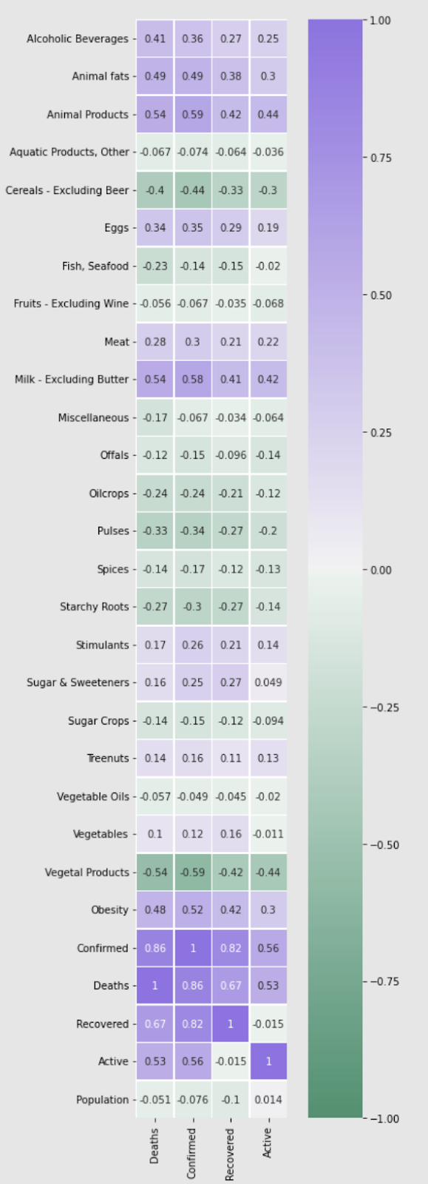
Question 1
What are the top three factors contributing to people getting COVID-19 in terms of diet?
Animal Fats
Animal Products
Milk
Notes:
Our first research question is what are the top three factors contributing to people getting COVID-19 in terms of diet
To figure out the top three factors, we use the correlation coefficient to represent how strong the connection between different diet ingredients and confirmed cases, recovery rate, and deaths.
As the heatmap shown, we can know that top 3 factors are animal products, animal fats, and milk.
It may be quite surprising that milk would contribute to covid-19. Therefore, we did some further research. There are indeed some papers indicates that different dairy products might lead to different degrees of getting COVID-19, and high-fat-dairy-products may increase the probability of COVID-19.
Since our data resource does not provide a specific description of the variety of dairy product, our result is actually reasonable though unexpected.

Slide 7
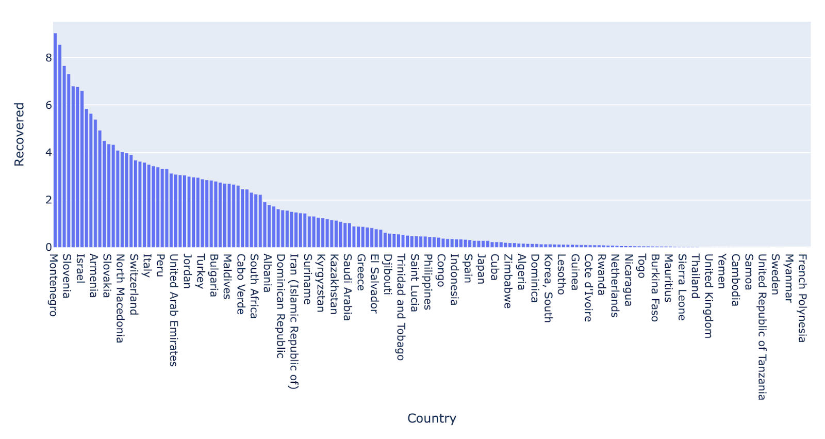
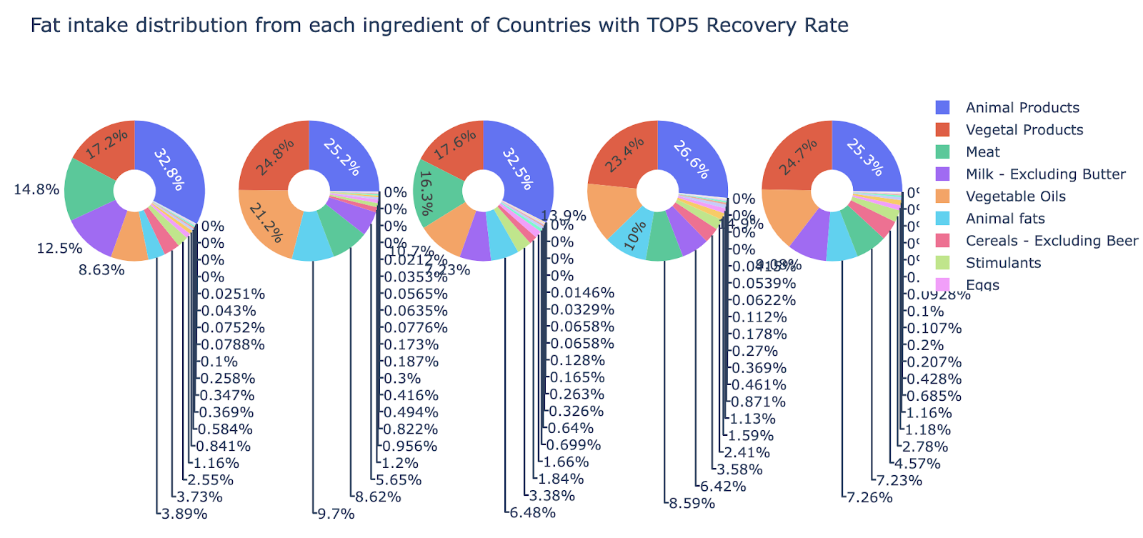
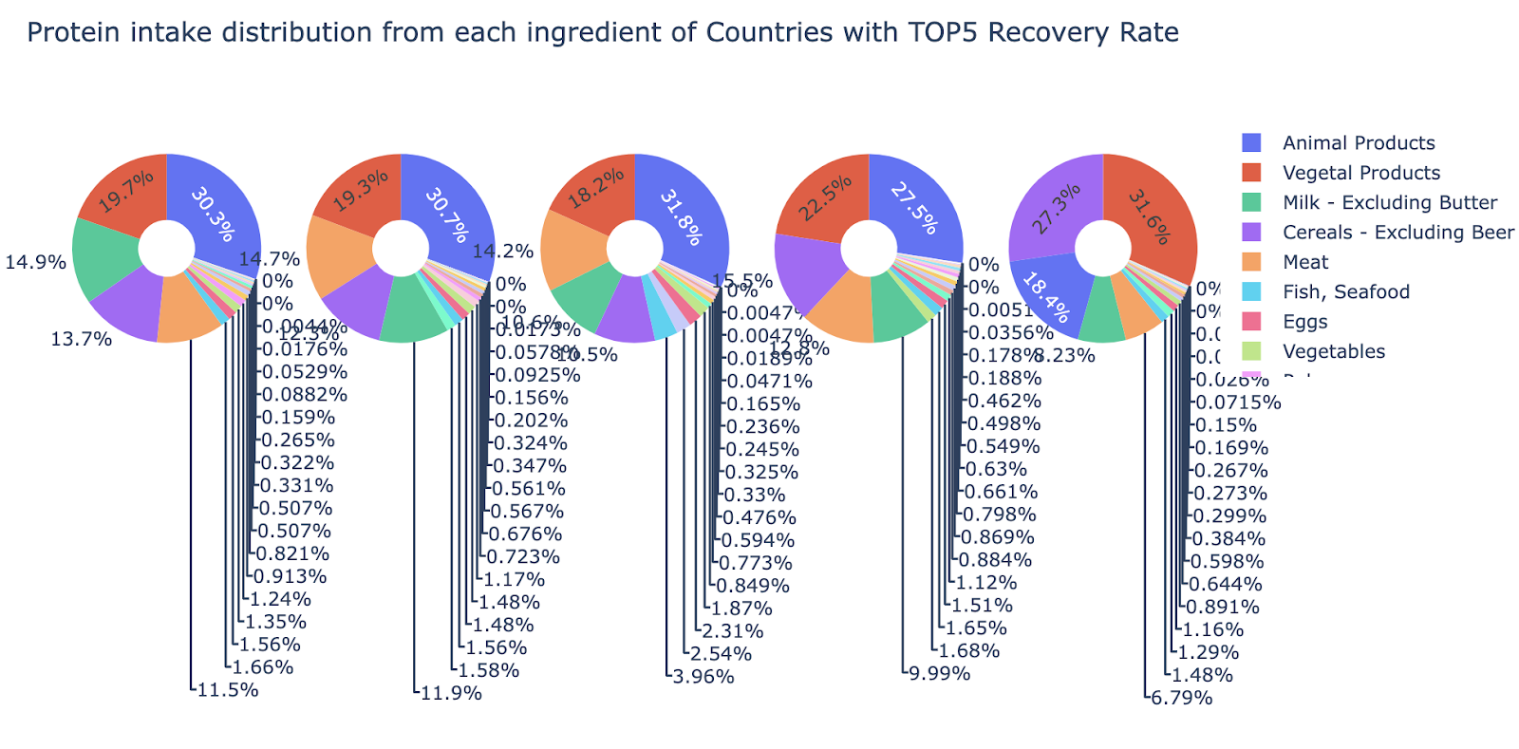
Question 2
Does intake of more fat or intake of more protein help people get away from COVID-19?
Notes:
Our second research question is that Does intake of more fat or intake of more protein help people get away from COVID-19?
Because we have the column recovery in our dataset, we first find out top 5 countries with high recovery rate.
Then we use pie charts to explore the intake distribution of protein and fat from different diet ingredients. And we get following pie charts as the figure shown.
Combining all plots, we can know that all three factors contribute slightly more to fat intake than protein intake, which imply that fat seems to be more helpful to covid-19 recovery.
It is pretty unbelievable right?
To justify our result, we process from the opposite perspective, we find top 5 countries with high death rate by taking advantage of deaths column. And repeat the procedure above, we surprisingly found out the result is opposite to the previous result obtained from the top 5 recovery rate countries.
This implies our previous conclusion was correct. Intake of fat may help people get away from covid-19.
In addition, in other research, it suggests that obesity increases the risk of severe illness from COVID-19, which is more intuitive.
Finally, we get our conclusion that a small intake of fat that might help with COVID-19 recovery, but too much of fat intake will cause irretrievable deterioration to the disease.

Slide 8

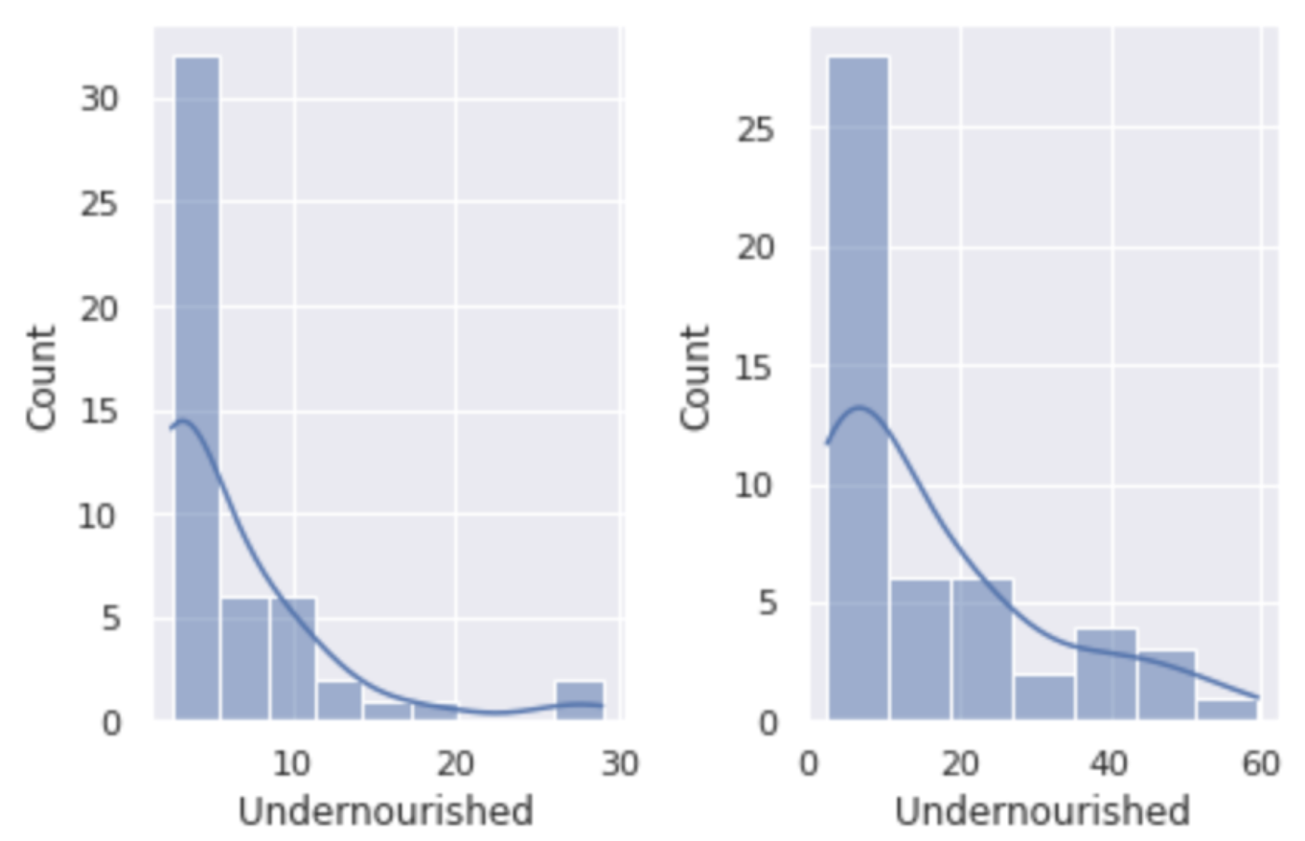
Question 3
Is there a significant difference between undernourished countries with a higher recovery rate and lower recovery rate？
Hypothesis Statement: H0: μ1 = μ2 H1: μ1 ≠ μ2
High Recovery Rate country
Low Recovery Rate country
Calculation Statistics:
t - statistic=-3.694
p -value=0.000364
Therefore:
p-value is smaller than the significance level, we reject the null hypothesis.
Conclusion:
We have enough evidence to support that there is a significant difference between the eating habits in countries with a higher recovery rate and countries with a lower recovery rate.

Slide 9
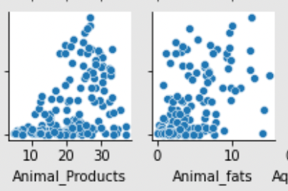
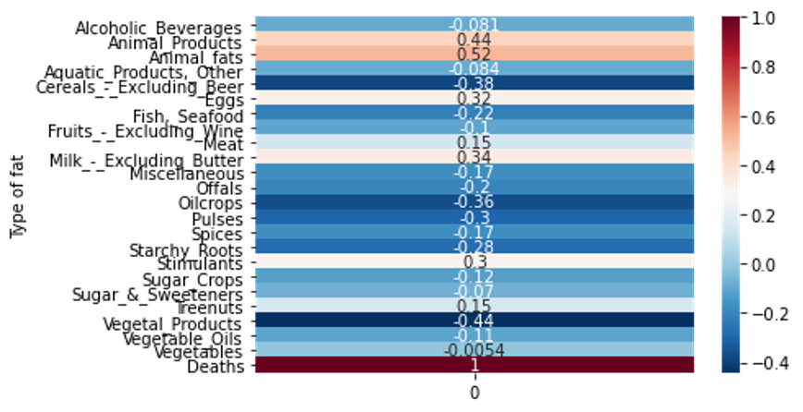
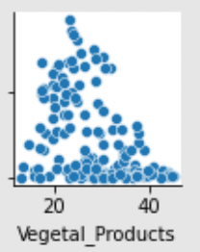
Question 4
Does there appear to be a relationship between the number of deaths from COVID and the amount of intake from fat?
Figure. Zoom in scatterplots for animal products, animal fats, and vegetable products against death rate
Figure. Heatmap of correlation of fat intake food with death rate

Slide 10
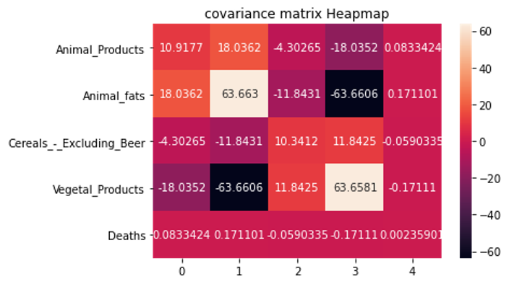
Figure. Heatmap for covariance matrix

Slide 11
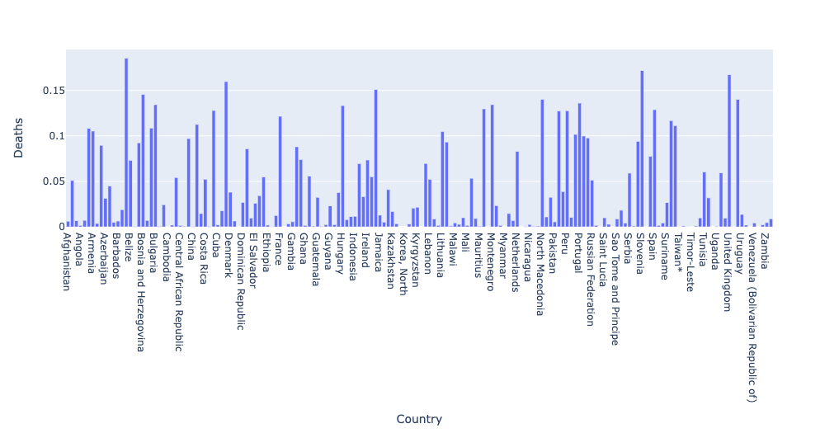
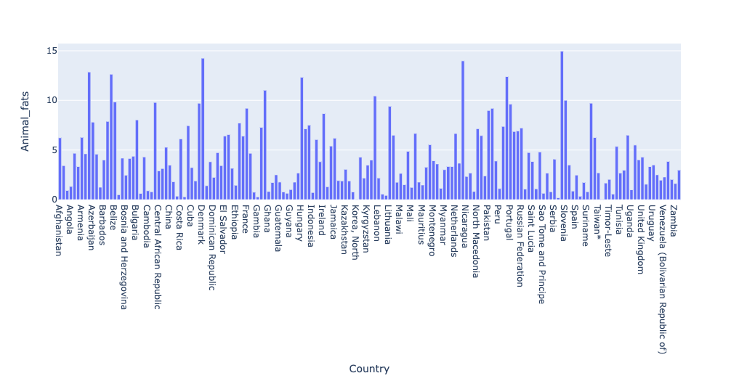

Slide 12
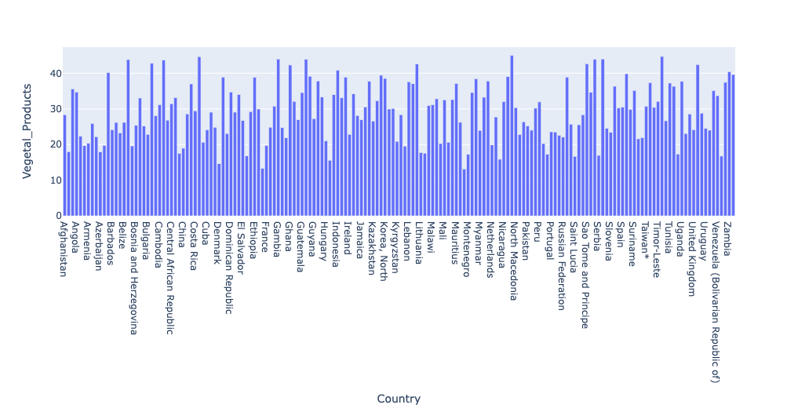

Slide 13
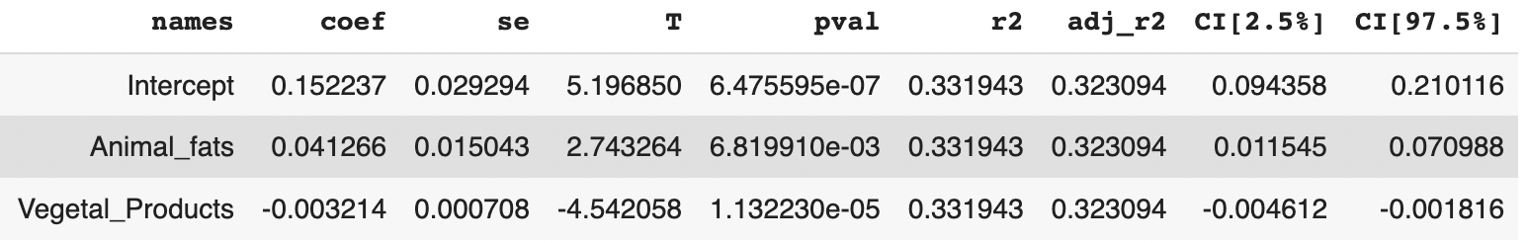
Animal fats and vegetable products are two main factors of fat intake that have relationship with death rate.

Slide 14



Question 5
Use multiple machine learning models to find the best tune model by comparing the predicted accuracy and mean squared error. Finding and predicting Wendy’s diet habit’s recovery rate.
Decision Tree (GridsearchCV)
Best tune model:
{'max_depth': 5,
'max_features': None,
'max_leaf_nodes': 40,
'min_samples_leaf': 5,
'min_weight_fraction_leaf': 0.1,
'splitter': 'random'}
Random Forest (RandomizedSearchCV)
Best tune model:
{'n_estimators': 20, 'min_samples_split': 10, 'min_samples_leaf': 4, 'max_features': 'auto', 'max_depth': 40, 'bootstrap': True}

Slide 15
Compared two tuned models…
Decision Tree Regressor:
MSE: 3.6061338216070937
RMSE: 1.8989823120837892
accuracy score: 0.23386092370459166
Random Forest Regressor
MSE: 3.073229627619313
RMSE: 1.7530629274556326
accuracy score: 0.08287347653186317
Tuned Decision Tree regressor is better. Have smaller MSE and RMSE and higher accuracy score.

Slide 16
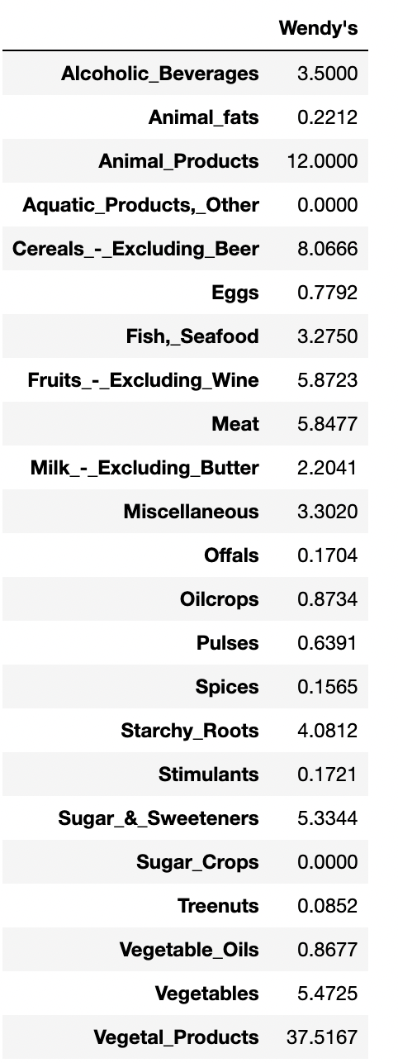
Wendy's recovery rate: 1.35789416%
All countries‘ recovery rate around the world: 0.4769941136691255% .

Slide 17
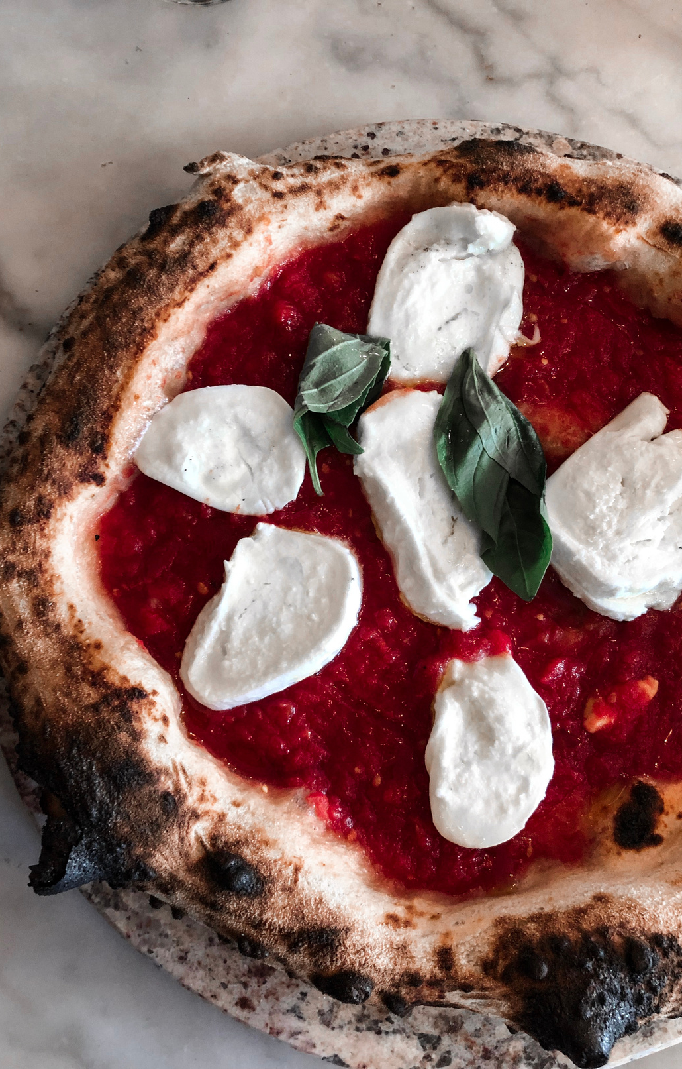
Key Takeaways:
Animal products, animal fats, and milk are top 3 factors contributing to getting COVID-19.
A small intake of fat that might help with COVID-19 recovery, but too much of fat intake will cause irretrievable deterioration to the disease.
Adequate nutrition is a vital in recovery from COVID-19
Animal fats and vegetable products are two main factors of fat intake that have relationship with death rate.
Decision tree tuned model is better to predict here.

Slide 18
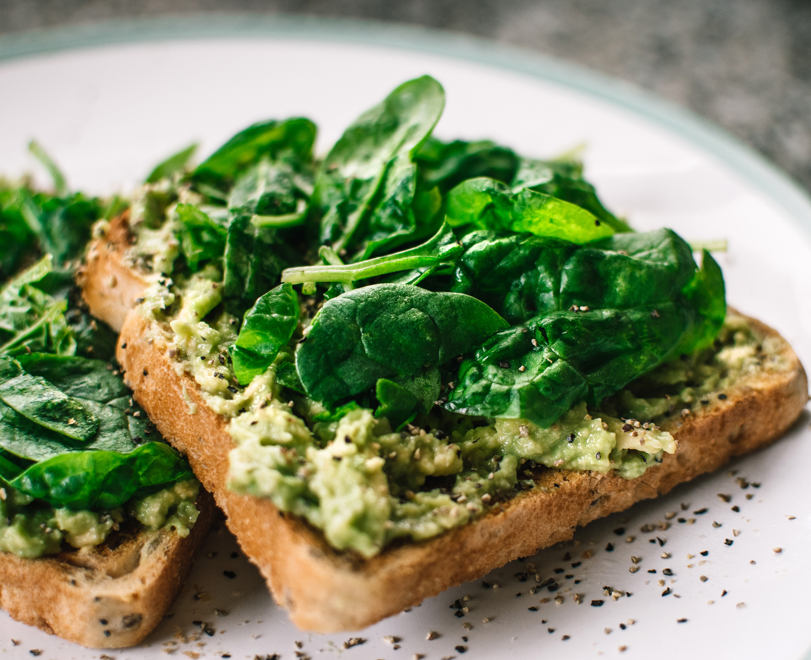
Tasks for Future
Currently, this research result can be only use as a reference…
The data is limited…
The data is from 2020. It might have some change in today’s world.
We are not 100% sure that the authors did not modify any data in the middle of the transformation.
We only have a very general data set.
Therefore:
We need more evidence to support our conclusion even interview with people who live in a specific country and see their experience with COVID-19 and eating habit

Slide 19
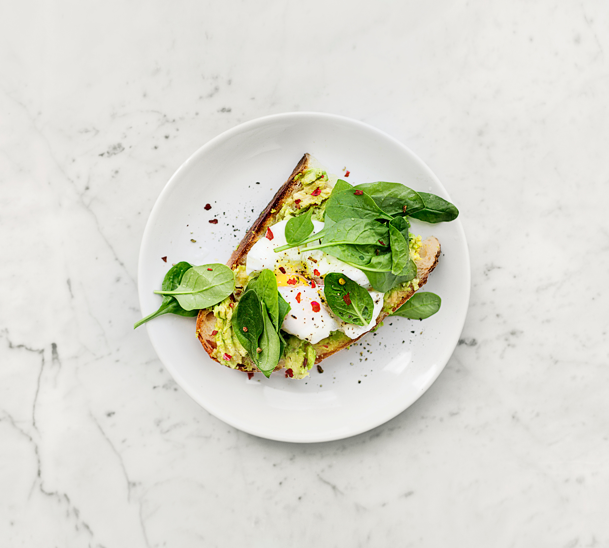
THANK YOU!
Hope we are all in good health

